Slide 1
CSD3009 -
DATA STRUCTURES AND ANALYSIS OF ALGORITHMS
DR.S.DEVARAJU

Slide 2
Module 3
Trees and Graphs: Trees: Binary tree, Binary search tree, threaded binary tree, Height balanced trees, Tries, Heaps, Hash tables. Graph traversals: Breadth-First Search, Depth First Search, Shortest path: Depth-first search in directed and undirected graphs. Union-find data structure and applications. Directed acyclic graphs; topological sort.
https://www.javatpoint.com/data-structure-tutorial

Slide 3
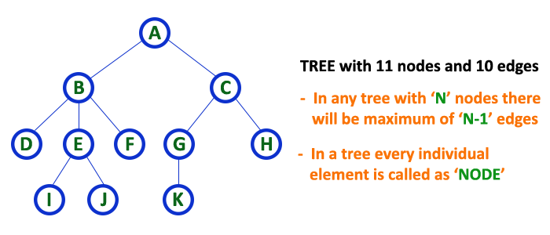
Tree Definition
Tree is a non-linear data structure which organizes data in hierarchical structure and this is a recursive definition.

Slide 4

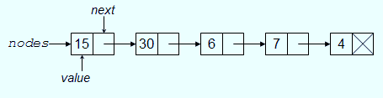
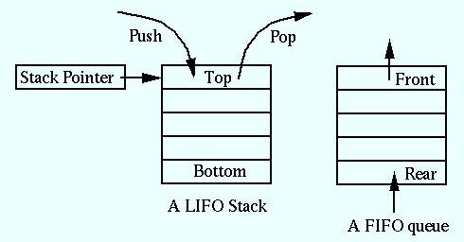
Data structure
Store and organize data in computer.
Linear Data Structure
Arrays
Linked List
Stacks
Queues

Slide 5

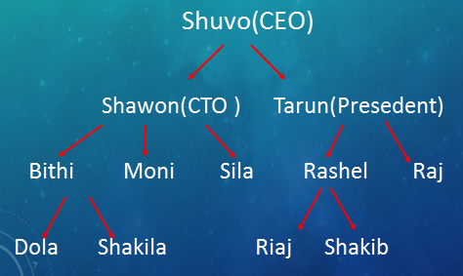
Logic of Tree

Slide 6

Logic of Tree

Slide 7
Tree Definition
Tree is a non-linear data structure which organizes data in hierarchical structure and this is a recursive definition.

Slide 8
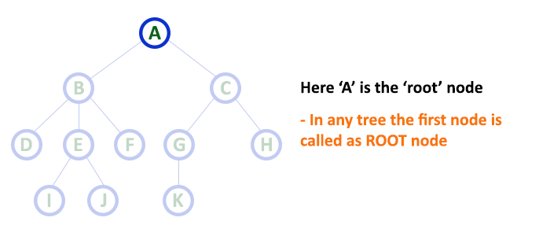
Tree terminology...
1.Root:
  The first node is called as Root Node.
  Every tree must have root node, there must be only one root node.
  Root node doesn't have any parent.

Slide 9
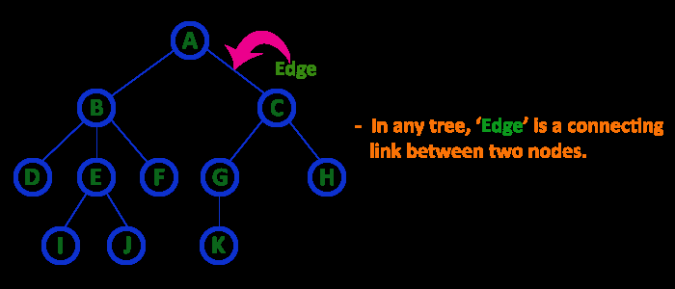
2. Edge
In a tree data structure, the connecting link between any two nodes is called as EDGE. In a tree with 'N' number of nodes there will be a maximum of 'N-1' number of edges.

Slide 10
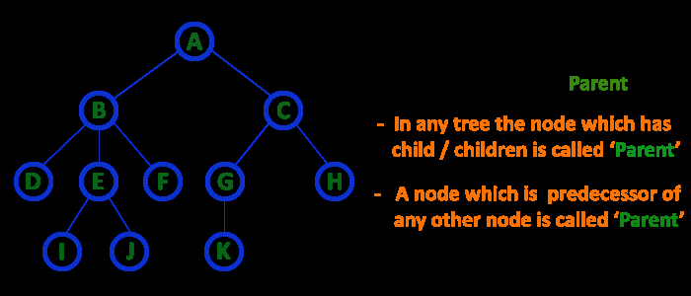
3. Parent
In a tree data structure, the node which is predecessor of any node is called as PARENT NODE. In simple words, the node which has branch from it to any other node is called as parent node. Parent node can also be defined as "The node which has child / children".

Slide 11
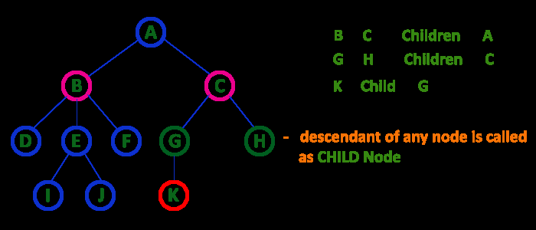
4. Child
The node which has a link from its parent node is called as child node.
In a tree, any parent node can have any number of child nodes.
In a tree, all the nodes except root are child nodes.

Slide 12
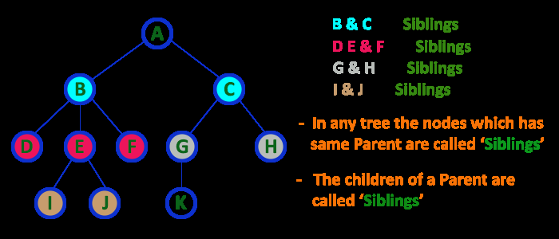
5. Siblings
The nodes with same parent are called as Sibling nodes.

Slide 13
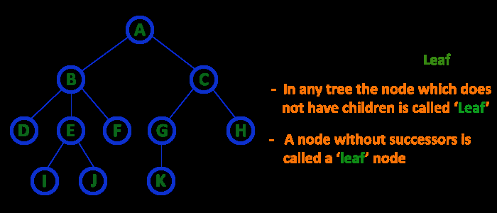
6. Leaf Node
The node which does not have a child is called as LEAF Node.
The leaf nodes are also called as External Nodes or 'Terminal' node.

Slide 14
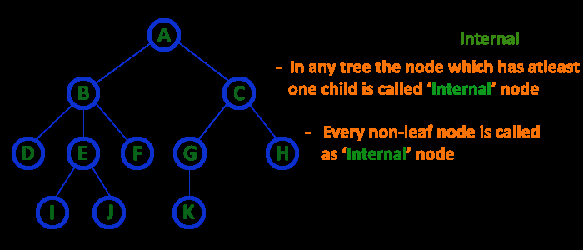
7. Internal Nodes
An internal node is a node with atleast one child.
Nodes other than leaf nodes are called as Internal Nodes.
The root node is also said to be Internal Node if the tree has more than one node. Internal nodes are also called as 'Non-Terminal' nodes.

Slide 15
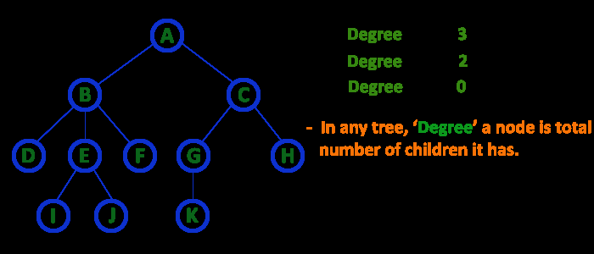
8. Degree
In a tree data structure, the total number of children of a node is called as DEGREE of that Node.

Slide 16
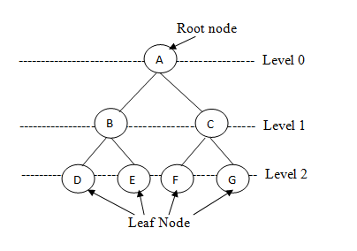
9. Level
In a tree data structure, the root node is said to be at Level 0 and the children of root node are at Level 1 and the children of the nodes which are at Level 1 will be at Level 2 and so on...
In a tree each step from top to bottom is called as a Level and the Level count starts with '0' and incremented by one at each level (Step).

Slide 17
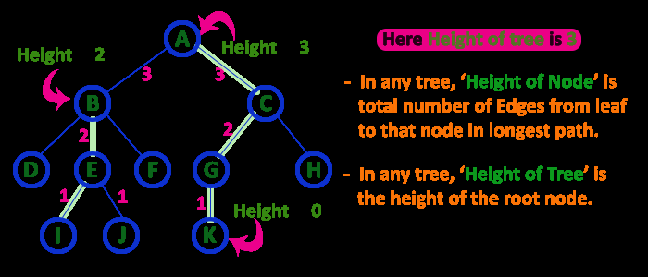
10. Height
the total number of egdes from leaf node to a particular node in the longest path is called as HEIGHT of that Node.
In a tree, height of the root node is said to be height of the tree.

Slide 18
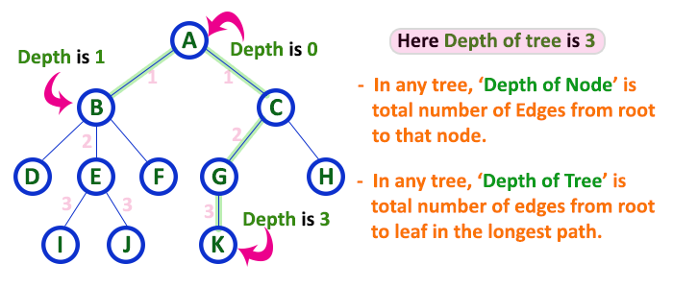
11. Depth
In a tree data structure, the total number of egdes from root node to a particular node is called as DEPTH of that Node.

Slide 19
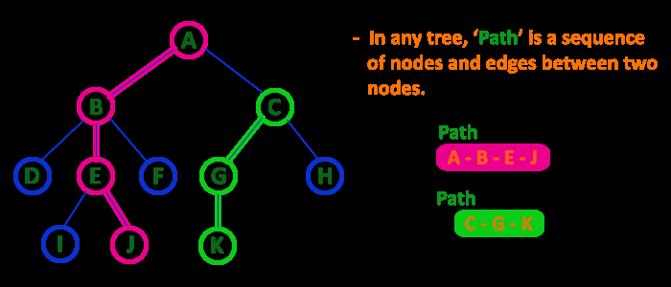
12. Path
In a tree data structure, the sequence of Nodes and Edges from one node to another node is called as PATH between that two Nodes.
Length of a Path is total number of nodes in that path. In below example the path A - B - E - J has length 4.

Slide 20
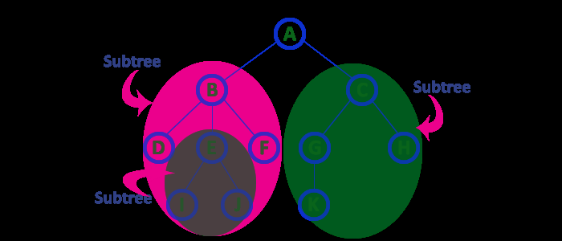
13. Sub Tree
Every child node will form a subtree on its parent node.

Slide 21
Type of Trees
General tree
Binary tree
Binary Search Tree

Slide 22
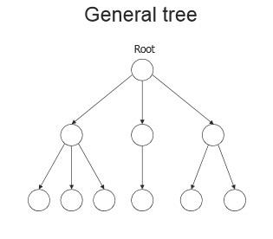
General Tree
A general tree is a data structure in that each node can have infinite number of children .
In general tree, root has in-degree 0 and maximum out-degree n.
Height of a general tree is the length of longest path from root to the leaf of tree. Height(T) = {max(height(child1) , height(child2) , … height(child-n) ) +1}

Slide 23
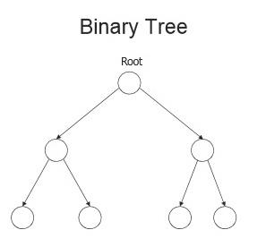
Binary tree
A Binary tree is a data structure in that each node has at most two nodes left and right
In binary tree, root has in-degree 0 and maximum out-degree 2.
In binary tree, each node have in-degree one and maximum out-degree 2.
Height of a binary tree is : Height(T) = { max (Height(Left Child) , Height(Right Child) + 1}

Slide 24
Representation of Binary Tree
Array Representation
Linked List Representation.

Slide 25
Representation of Binary Tree
Struct node { int data; struct node * left,right; };

Slide 26
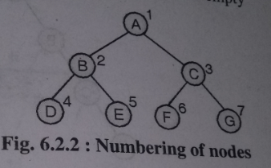

Array Representation
To represent a tree in one dimensional array nodes are marked sequentially from left to right start with root node.
First array location can be used to store no of nodes in a tree.

Slide 27
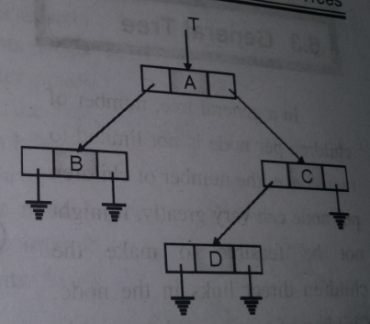
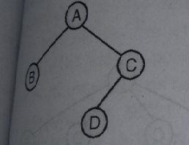
Linked Representation
This type of representation is more efficient as compared to array.
Left and right are pointer type fields left holds address of left child and right holds address of right child.
Struct node
{
int data;
struct node * left,*right;
};

Slide 28
Binary Tree Types
Extended Binary Tree
Complete Binary Tree
Full Binary Tree
Skewed Binary Tree
Strictly Binary Tree
Expression Binary tree

Slide 29
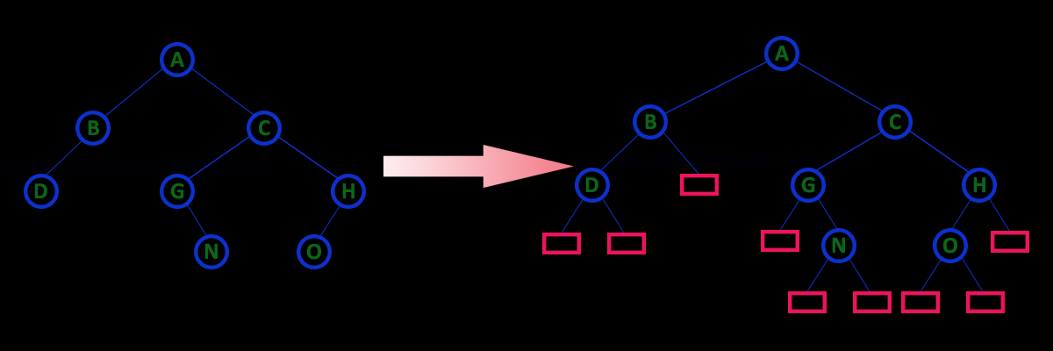
1. Extended Binary Tree
An extended binary tree is a transformation of any binary tree into a complete binary tree. This transformation consists of replacing every null subtree of the original tree with “special nodes” or “failure nodes” .The nodes from the original tree are then internal nodes, while the “special nodes” are external nodes.

Slide 30
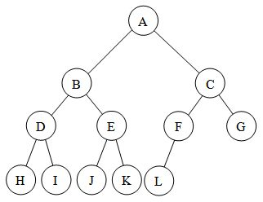
Complete Binary Tree
A complete binary tree is a tree in which
1.All leaf nodes are at n or n-1 level
2.Levels are filled from left to right

Slide 31
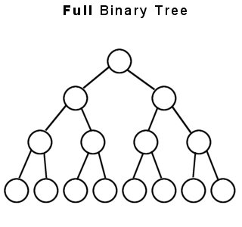
Full Binary Tree
A full binary tree (sometimes proper binary tree or 2-tree) is a tree in which every node other than the leaves has two children or no childeren. Every level is completely filled up.
No of nodes= 2^{h+1} -1

Slide 32
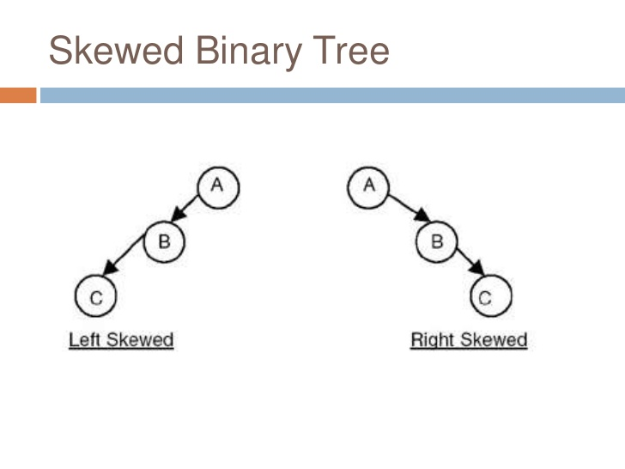
Skewed Binary Tree
A binary tree is said to be Skewed Binary Tree if every node in the tree contains either only left or only right sub tree. If the node contains only left sub tree then it is called left-skewed binary tree and if the tree contains only right sub tree then it is called right-skewed binary tree.

Slide 33
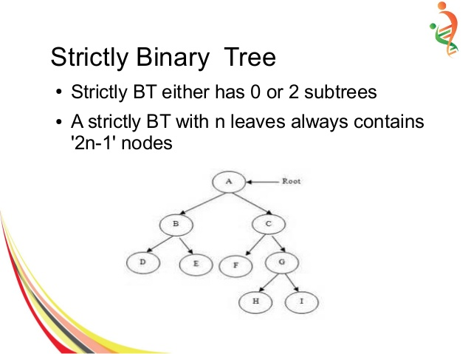
Strictly Binary Tree
A node will have either two children or no child at all.

Slide 34
Expression Binary tree
Expression trees are a special kind of binary tree used to evaluate certain expressions.
Two common types of expressions that a binary expression tree can represent are algebraic and boolean.
These trees can represent expressions that contain both unary and binary operators.
The leaves of a binary expression tree are operands, such as constants or variable names, and the other nodes contain operators.
Expression tree are used in most compilers.

Slide 35
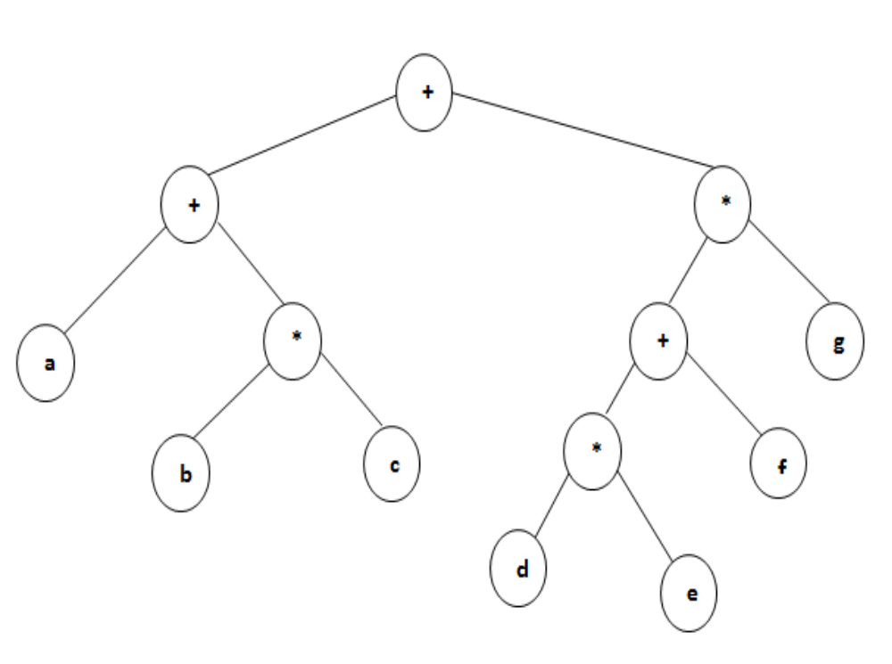
https://www.youtube.com/watch?v=NGEKaXpGAT8

Slide 36
Binary Tree Traversal
Preorder traversal:-
In this traversal method first process root element, then left sub tree and then right sub tree.
Procedure:-
Step 1: Visit root node
Step 2: Visit left sub tree in preorder
Step 3: Visit right sub tree in preorder

Slide 37
2. Inorder traversal:-
In this traversal method first process left element, then root element and then the right element.
Procedure:-
Step 1: Visit left sub tree in inorder
Step 2: Visit root node
Step 3: Visit right sub tree in inorder

Slide 38
3. Postorder traversal:-
In this traversal first visit / process left sub tree, then right sub tree and then the root element.
Procedure:-
Step 1: Visit left sub tree in postorder
Step 2: Visit right sub tree in postorder
Step 3: Visit root node

Slide 39
Binary Search Tree
Part-1/2 - https://www.youtube.com/watch?v=KGcrQj0pqMo
Part-2/2 - https://www.youtube.com/watch?v=vzmmOL4Bx4Y
expression tree: https://www.youtube.com/watch?v=NGEKaXpGAT8
Binary Search Tree Traversal: https://www.youtube.com/watch?v=UjIiNK6OVDU
Searching in Binary Search Tree: https://www.youtube.com/watch?v=Y5rCIBa5edg
Insertion in Binary Search Tree: https://www.youtube.com/watch?v=BzOgSh7YxuM
Deletion in Binary Search Tree: https://www.youtube.com/watch?v=9kF8il8_7ag

Slide 40
Binary Search Tree
A binary search tree (BST) or "ordered binary tree" is a empty or in which each node contains a key that satisfies following conditions:
    All keys are distinct.’
    all elements in its left subtree are less to the node (<), and all the elements in its right subtree are greater than the node (>).
Part-1/2 - https://www.youtube.com/watch?v=KGcrQj0pqMo
Part-2/2 - https://www.youtube.com/watch?v=vzmmOL4Bx4Y
expression tree: https://www.youtube.com/watch?v=NGEKaXpGAT8
Binary Search Tree Traversal: https://www.youtube.com/watch?v=UjIiNK6OVDU

Slide 41
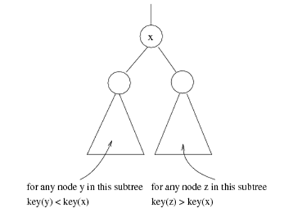
Binary search tree
Binary search tree property
  For every node X
  All the keys in its left
  subtree are smaller than
  the key value in X
  All the keys in its right
  subtree are larger than the
  key value in X

Slide 42

Binary Search Trees
A binary search tree
Not a binary search tree

Slide 43
Tries

Slide 44
Definition
Trie data structure is defined as a Tree based data structure that is used for storing some collection of strings and performing efficient search operations on them.
The word Trie is derived from reTRIEval, which means finding something or obtaining it.

Slide 45
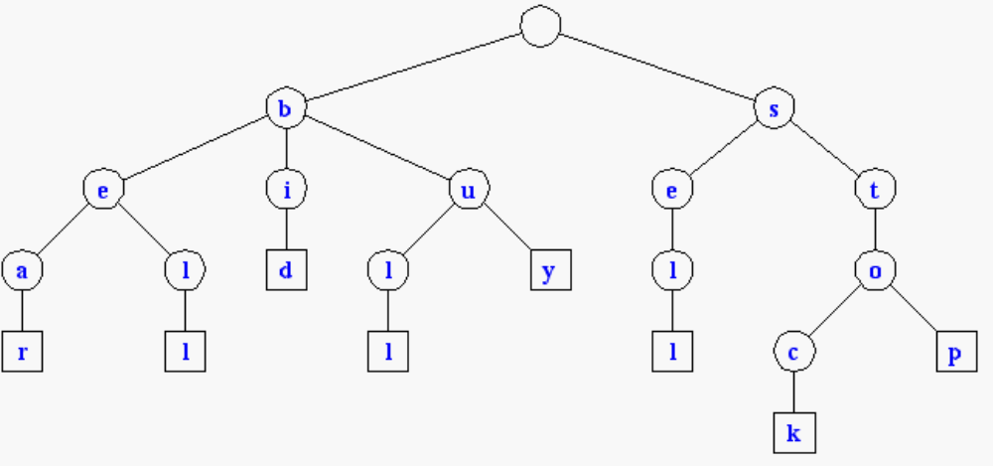
Tries
Standard Tries
Compressed Tries
Suffix Tries

Slide 46
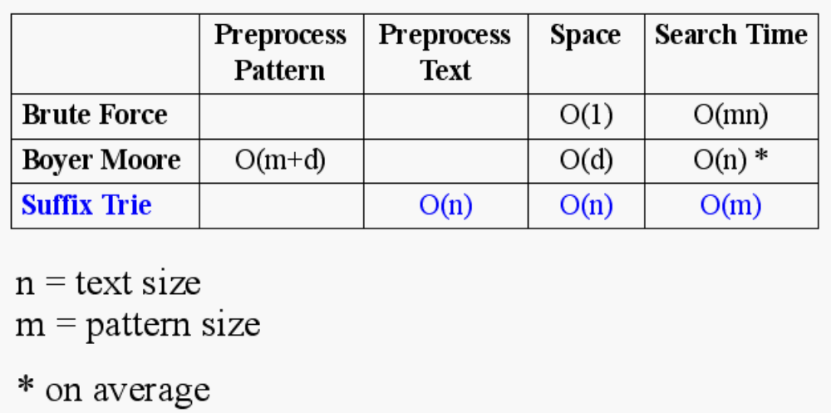
Text Processing
We have seen that preprocessing the pattern speeds up pattern matching queries
After preprocessing the pattern in time proportional to the pattern length, the Boyer-Moore algorithm searches an arbitrary English text in (average) time proportional to the text length
If the text is large, immutable and searched for often (e.g., works by Shakespeare), we may want to preprocess the text instead of the pattern in order to perform pattern matching queries in time proportional to the pattern length.
Tradeoffs in text searching

Slide 47
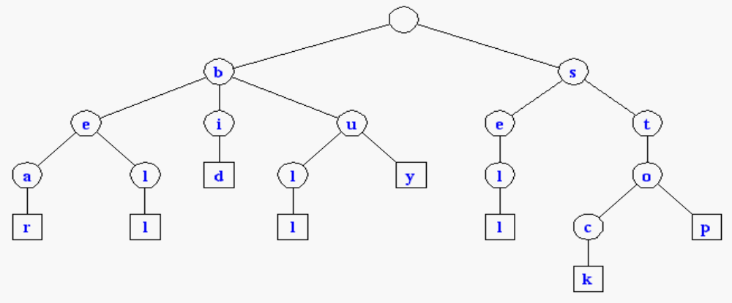
Standard Tries
The standard trie for a set of strings S is an ordered tree such that:
  each node but the root is labeled with a character
  the children of a node are alphabetically ordered
  the paths from the external nodes to the root yield the strings of S
Example: standard trie for
the set of strings
S = { bear, bell, bid, bull,
buy, sell, stock, stop }
A standard trie uses O(n) space. Operations (find, insert, remove) take time O(dm) each, where:
-n = total size of the strings in S,
-m =size of the string parameter of the operation
-d =alphabet size,

Slide 48
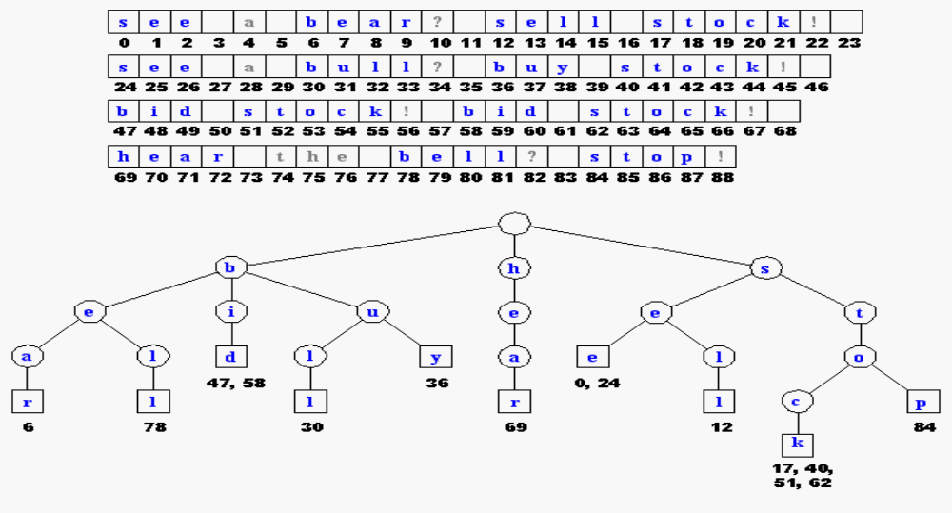
Applications of Tries
A standard trie supports the following operations on a preprocessed text in time O(m), where m = |X|
-word matching: find the first occurence of word X in the text
-prefix matching: find the first occurrence of the longest prefix of word X in the text
Each operation is performed by tracing a path in the trie starting at the root

Slide 49
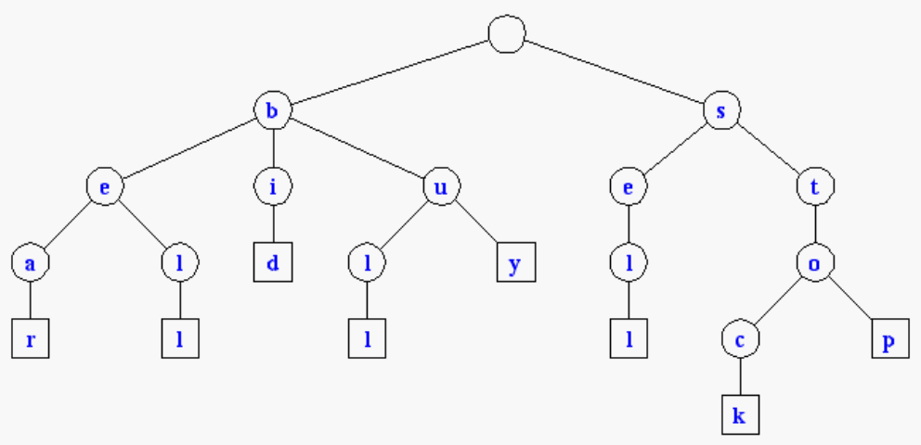
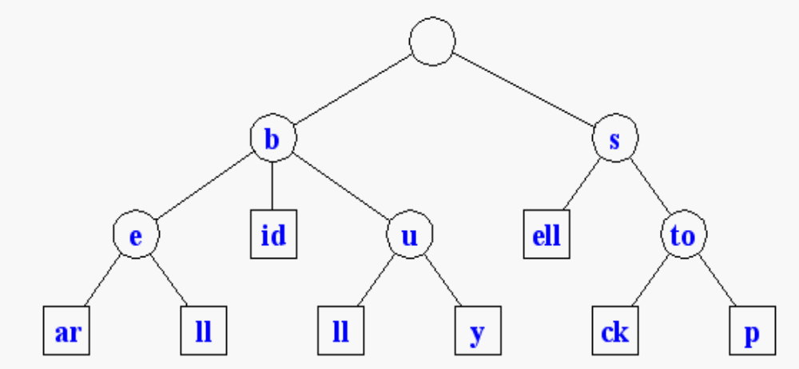
Compressed Tries
Trie with nodes of degree at least 2
Obtained from standard trie by compressing chains of redundant nodes
Standard Trie:
Compressed Trie:

Slide 50
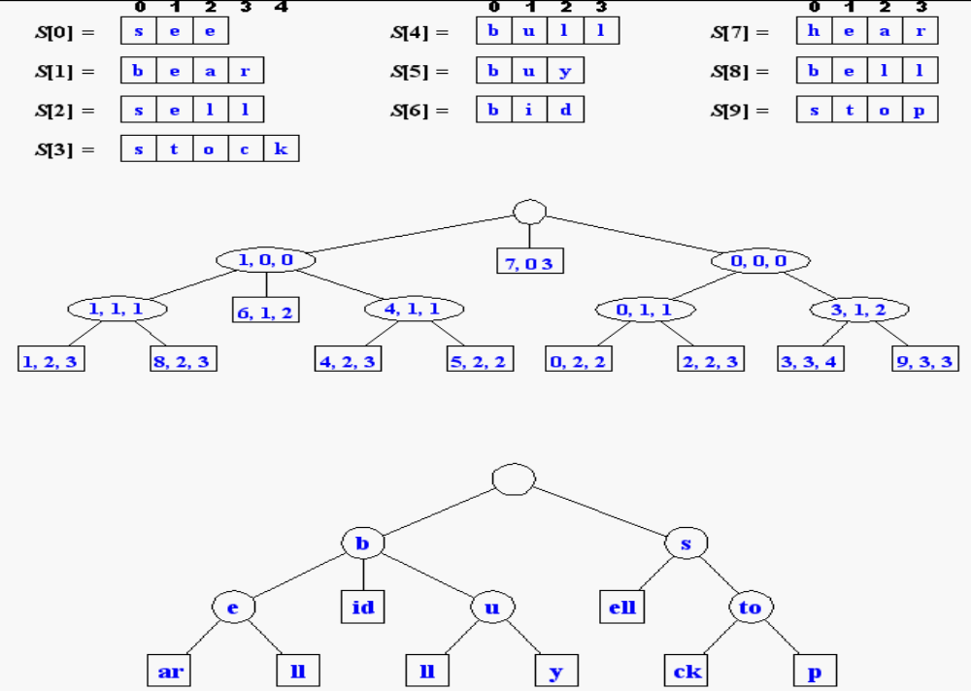
Compact Storage of Compressed Tries
A compressed trie can be stored in space O(s), where s = |S|, by using O(1) space index ranges at the nodes

Slide 51
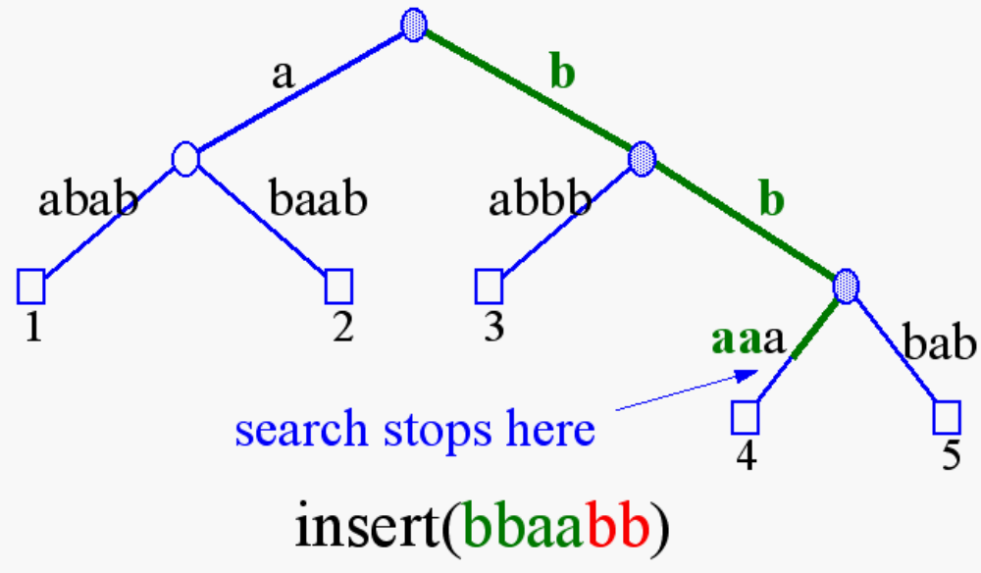
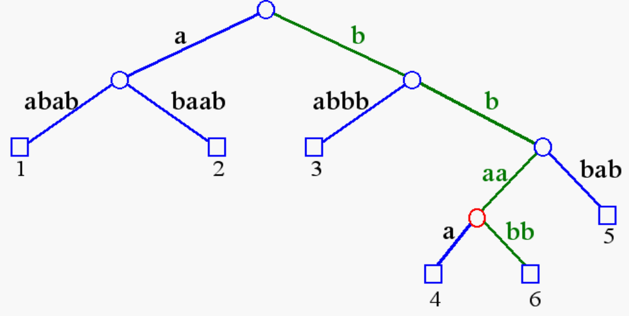
Insertion and Deletion into/from a Compressed Trie
https://www.youtube.com/watch?v=-urNrIAQnNo

Slide 52
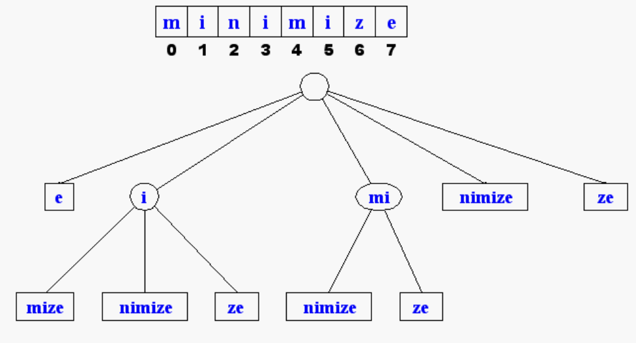
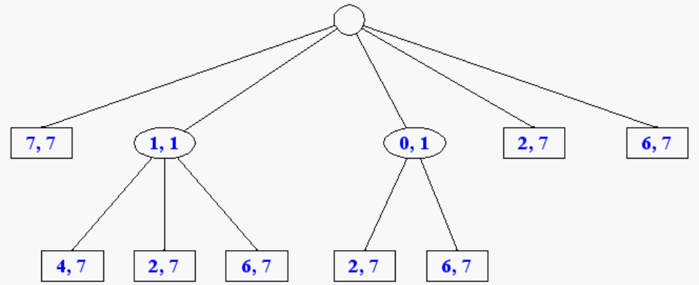
Suffix Tries
A suffix trie is a compressed trie for all the suffixes of a text
Example:
Compact representation:

Slide 53
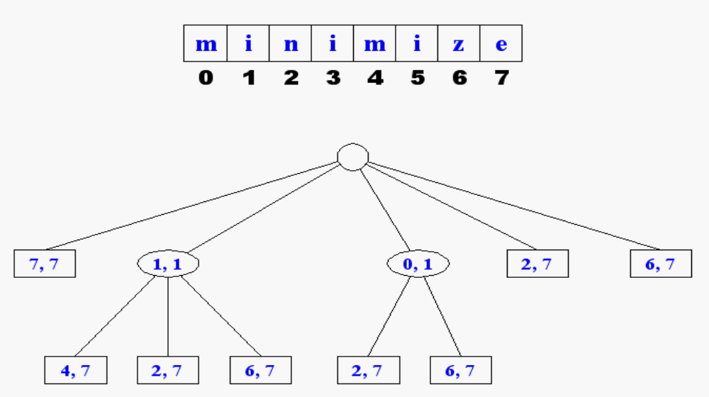
Properties of Suffix Tries
The suffix trie for a text X of size n from an alphabet of size d
-stores all the n(n-1)/2 suffixes of X in O(n) space
-supports arbitrary pattern matching and prefix matching queries in O(dm) time, where m is the length of the pattern
-can be constructed in O(dn) time

Slide 54

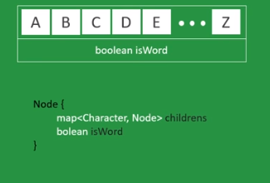
Example

Slide 55
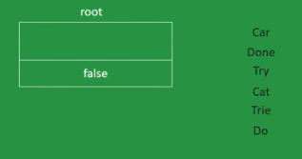
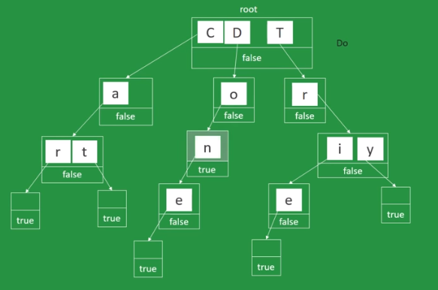
Insersion

Slide 56
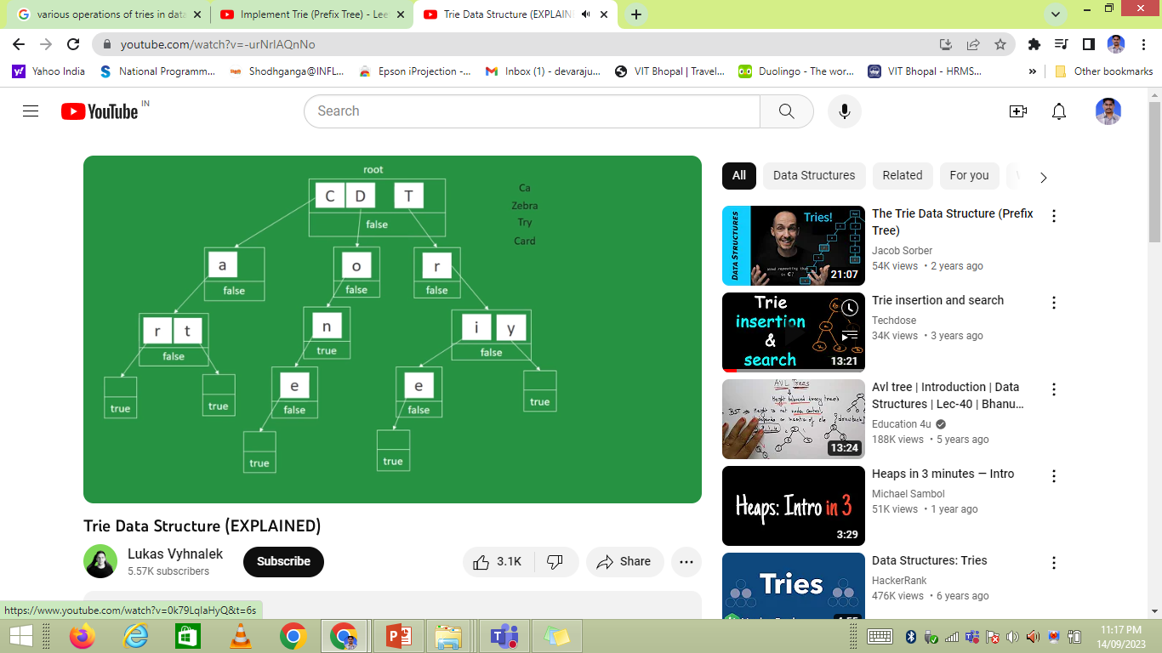
Search
No
No
Yes
No

Slide 57
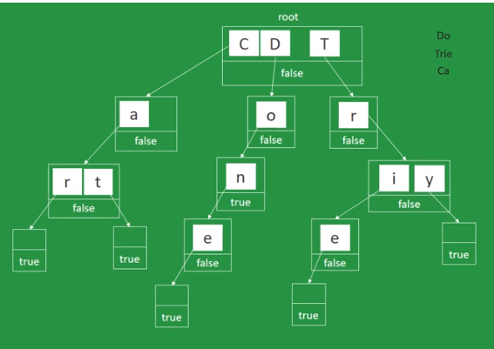
Deletion (before)

Slide 58
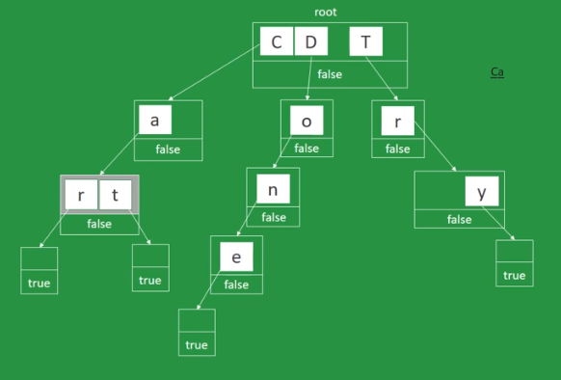
Deletion (after)

Slide 59
Tries and Web Search Engines
The index of a search engine (collection of all searchable words) is stored into a compressed trie
Each leaf of the trie is associated with a word and has a list of pages (URLs) containing that word, called occurrence list
The trie is kept in internal memory
The occurrence lists are kept in external memory and are ranked by relevance
Boolean queries for sets of words (e.g., Java and coffee) correspond to set operations (e.g., intersection) on the occurrence lists
Additional information retrieval techniques are used, such as
  stopword elimination (e.g., ignore “the” “a” “is”)
  stemming (e.g., identify “add” “adding” “added”)
  link analysis (recognize authoritative pages)

Slide 60
Tries and Internet Routers
Computers on the internet (hosts) are identified by a unique 32-bit IP (internet protocol) addres, usually written in “dotted-quad-decimal” notation
E.g., www.cs.brown.edu is 128.148.32.110
Use nslookup on Unix to find out IP addresses
An organization uses a subset of IP addresses with the same prefix, e.g., Brown uses 128.148.*.*, Yale uses 130.132.*.*
Data is sent to a host by fragmenting it into packets. Each packet carries the IP address of its destination.
The internet whose nodes are routers, and whose edges are communication links.
A router forwards packets to its neighbors using IP prefix matching rules. E.g., a packet with IP prefix 128.148. should be forwarded to the Brown gateway router.
Routers use tries on the alphabet 0,1 to do prefix matching.

Slide 61
Heaps
Notes:
A heap is a data structure with several applications, including a way to implement Priority Queues, as shown in Chapter 11. The definition of a heap is a special kind of complete binary tree.
You probably recall that a complete binary tree requires that its nodes are added in a particular order...

Slide 62
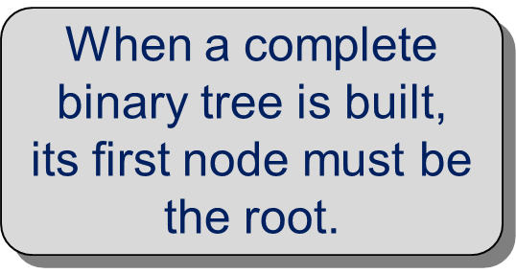
Heaps
Root
A heap is a certain kind of complete binary tree.
Notes:
The first node of a complete binary tree is always the root...

Slide 63
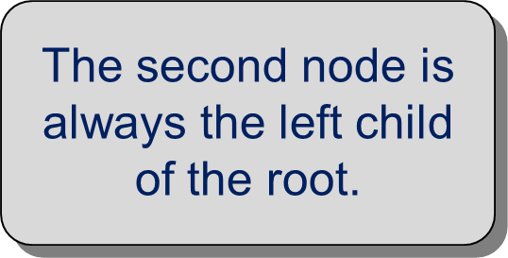
Heaps
Complete binary tree.
Left child
of the
root
Notes:
...the second node is always the left child of the root...

Slide 64
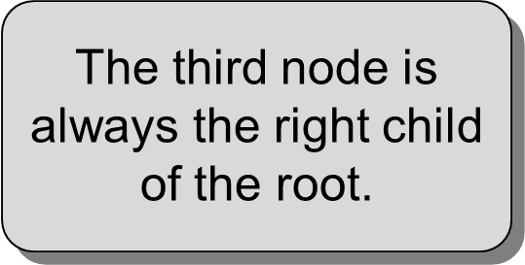
Heaps
Complete binary tree.
Right child
of the
root
Notes:
...then the right child of the root...

Slide 65

Heaps
Complete binary tree.
Notes:
...and so on. The nodes always fill each level from left-to-right...

Slide 66

Heaps
Complete binary tree.
Notes:
...from left-to-right...

Slide 67
Heaps
Complete binary tree.
Notes:
...from left-to-right...

Slide 68
Heaps
Complete binary tree.
Notes:
...from left-to-right...

Slide 69
Heaps
Complete binary tree.
Notes:
...and when a level is filled you start the next level at the left.

Slide 70

Heaps
A heap is a certain kind of complete binary tree.
45
35
23
27
21
22
4
19
Notes:
So, a heap is a complete binary tree. Each node in a heap contains a key, and these keys must be organized in a particular manner. Notice that this is not a binary search tree, but the keys do follow some semblance of order.
Can you see what rule is being enforced here?

Slide 71

Heaps
A heap is a certain kind of complete binary tree.
45
35
23
27
21
22
4
19
Notes:
The heap property requires that each node's key is >= to the keys of its children.
This is a handy property because the biggest node is always at the top. Because of this, a heap can easily implement a priority queue (where we need quick access to the highest priority item).

Slide 72
Adding a Node to a Heap
45
Put the new node in the next available spot.
Push the new node upward, swapping with its parent until the new node reaches an acceptable location.
35
23
27
21
22
4
19
42
Notes:
We can add new elements to a heap whenever we like. Because the heap is a complete binary search tree, we must add the new element at the next available location, filling in the levels from left-to-right.
In this example, I have just added the new element with a key of 42.
Of course, we now have a problem: The heap property is no longer valid. The 42 is bigger than its parent 27.
To fix the problem, we will push the new node upwards until it reaches an acceptable location.

Slide 73
Adding a Node to a Heap
Put the new node in the next available spot.
Push the new node upward, swapping with its parent until the new node reaches an acceptable location.
45
35
23
42
21
22
4
19
27
Notes:
Here we have pushed the 42 upward one level, swapping it with its smaller parent 27.
We can't stop here though, because the parent 35 is still smaller than the new node 42.

Slide 74
Adding a Node to a Heap
Put the new node in the next available spot.
Push the new node upward, swapping with its parent until the new node reaches an acceptable location.
45
42
23
35
21
22
4
19
27
Notes:
Can we stop now? Yes, because the 42 is less than or equal to its parent.

Slide 75
Adding a Node to a Heap
45
The parent has a key that is >= new node, or
The node reaches the root.
The process of pushing the new node upward is called reheapification upward.
42
23
35
21
22
4
19
27
Notes:
In general, there are two conditions that can stop the pushing upward:
1. We reach a spot where the parent is >= the new node, or
2. We reach the root.
This process is called reheapification upward (I didn't just make up that name, really).

Slide 76
Removing the Top of a Heap
45
Move the last node onto the root.
42
23
35
21
22
4
19
27
Notes:
We can also remove the top node from a heap. The first step of the removal is to move the last node of the tree onto the root. In this example we move the 27 onto the root.

Slide 77
Removing the Top of a Heap
27
Move the last node onto the root.
42
23
35
21
22
4
19
Notes:
Now the 27 is on top of the heap, and the original root (45) is no longer around. But the heap property is once again violated.

Slide 78
Removing the Top of a Heap
27
Move the last node onto the root.
Push the out-of-place node downward, swapping with its larger child until the new node reaches an acceptable location.
42
23
35
21
22
4
19
Notes:
We'll fix the problem by pushing the out-of-place node downward. Perhaps you can guess what the downward pushing is called....reheapification downward.

Slide 79
Removing the Top of a Heap
42
Move the last node onto the root.
Push the out-of-place node downward, swapping with its larger child until the new node reaches an acceptable location.
27
23
35
21
22
4
19
Notes:
When we push a node downward it is important to swap it with its largest child. (Otherwise we are creating extra problems by placing the smaller child on top of the larger child.) This is what the tree looks like after one swap.
Should I continue with the reheapification downward?

Slide 80
Removing the Top of a Heap
Move the last node onto the root.
Push the out-of-place node downward, swapping with its larger child until the new node reaches an acceptable location.
42
35
23
27
21
22
4
19
Notes:
Yes, I swap again, and now the 27 is in an acceptable location.

Slide 81
Removing the Top of a Heap
The children all have keys <= the out-of-place node, or
The node reaches the leaf.
The process of pushing the new node downward is called reheapification downward.
42
35
23
27
21
22
4
19
Notes:
Reheapification downward can stop under two circumstances:
1. The children all have keys that are <= the out-of-place node.
2. The out-of-place node reaches a leaf.

Slide 82
Implementing a Heap
42
We will store the data from the nodes in a partially-filled array.
35
23
27
21
An array of data
Notes:
This slide shows the typical way that a heap is implemented. For the most part, there is nothing new here, because you already know how to implement a complete binary tree using a partially-filled array. That is what we are doing with the heap.

Slide 83
Implementing a Heap
42
Data from the root goes in the first location of the array.
35
23
27
21
42
An array of data
Notes:
Following the usual technique for implementing a complete binary tree, the data from the root is stored in the first entry of the array.

Slide 84
Implementing a Heap
42
Data from the next row goes in the next two array locations.
35
23
27
21
42
35
23
An array of data
Notes:
The next two nodes go in the next two locations of the array.

Slide 85
Implementing a Heap
42
Data from the next row goes in the next two array locations.
35
23
27
21
42
35
23
27
21
An array of data
Notes:
and so on.

Slide 86
Implementing a Heap
42
Data from the next row goes in the next two array locations.
35
23
27
21
42
35
23
27
21
An array of data
We don't care what's in
this part of the array.
Notes:
As with any partially-filled array, we are only concerned with the front part of the array. If the tree has five nodes, then we are only concerned with the entries in the first five components of the array.

Slide 87
Important Points about the Implementation
42
The links between the tree's nodes are not actually stored as pointers, or in any other way.
The only way we "know" that "the array is a tree" is from the way we manipulate the data.
35
23
27
21
42
35
23
27
21
An array of data
Notes:
With this implementation of a heap, there are no pointers. The only way that we know that the array is a heap is the manner in which we manipulate it.

Slide 88
Important Points about the Implementation
42
If you know the index of a node, then it is easy to figure out the indexes of that node's parent and children.
35
23
27
21
42
35
23
27
21
[1] [2] [3] [4] [5]
Notes:
The manipulations are the same manipulations that you've used for a complete binary tree, making it easy to compute the index where various nodes are stored.

Slide 89
Summary
A heap is a complete binary tree, where the entry at each node is greater than or equal to the entries in its children.
To add an entry to a heap, place the new entry at the next available spot, and perform a reheapification upward.
To remove the biggest entry, move the last node onto the root, and perform a reheapification downward.
Notes:
A quick summary . . .

Slide 90

Hash Table

Slide 91
What is a Hash Table ?
The simplest kind of hash table is an array of records.
This example has 701 records.
[ 0 ]
[ 1 ]
[ 2 ]
[ 3 ]
[ 4 ]
[ 5 ]
[ 700]
. . .
An array of records
Notes:
This lecture introduces hash tables, which are an array-based method for implementing a Dictionary. You should recall that we have seen dictionaries implemented in other ways, for example with a binary search tree. The abstract properties of a dictionary remain the same: We can insert items in the dictionary, and each item has a key associated with it. When we want to retrieve an item, we specify only the key, and the retrieval process finds the associated data.
What we do now is use an array to implement the dictionary. The array is an array of records. In this example, we could store up to 701 records in the array.

Slide 92
What is a Hash Table ?
[ 4 ]
Number 506643548
Each record has a special field, called its key.
In this example, the key is a long integer field called Number.
[ 0 ]
[ 1 ]
[ 2 ]
[ 3 ]
[ 4 ]
[ 5 ]
[ 700]
. . .
Notes:
Each record in the array contains two parts. The first part is a number that we'll use for the key of the item. We could use something else for the keys, such as a string. But for a hash table, numbers make the most convenient keys.

Slide 93

What is a Hash Table ?
[ 4 ]
Number 506643548
The number might be a person's identification number, and the rest of the record has information about the person.
[ 0 ]
[ 1 ]
[ 2 ]
[ 3 ]
[ 4 ]
[ 5 ]
[ 700]
. . .
Notes:
The numbers might be identification numbers of some sort, and the rest of the record contains information about a person. So the pattern that you see here is the same pattern that you've seen in other dictionaries: Each entry in the dictionary has a key (in this case an identifying number) and some associated data.

Slide 94



What is a Hash Table ?
When a hash table is in use, some spots contain valid records, and other spots are "empty".
[ 0 ]
[ 1 ]
[ 2 ]
[ 3 ]
[ 4 ]
[ 5 ]
[ 700]
Number 281942902
Number 233667136
Number 506643548
. . .
Number 155778322
Notes:
When a hash table is being used as a dictionary, some of the array locations are in use, and other spots are "empty", waiting for a new entry to come along.
Oftentimes, the empty spots are identified by a special key. For example, if all our identification numbers are positive, then we could use 0 as the Number that indicates an empty spot.
With this drawing, locations [0], [4], [6], and maybe some others would all have Number=0.

Slide 95

Inserting a New Record
Number 580625685
In order to insert a new record, the key must somehow be converted to an array index.
The index is called the hash value of the key.
[ 0 ]
[ 1 ]
[ 2 ]
[ 3 ]
[ 4 ]
[ 5 ]
[ 700]
Number 281942902
Number 233667136
Number 506643548
. . .
Number 155778322
Notes:
In order to insert a new entry, the key of the entry must somehow be converted to an index in the array. For our example, we must convert the key number into an index between 0 and 700. The conversion process is called hashing and the index is called the hash value of the key.

Slide 96
Inserting a New Record
Number 580625685
Typical way create a hash value:
(Number mod 701)
What is (580625685 mod 701) ?
[ 0 ]
[ 1 ]
[ 2 ]
[ 3 ]
[ 4 ]
[ 5 ]
[ 700]
Number 281942902
Number 233667136
Number 506643548
. . .
Number 155778322
Notes:
There are many ways to create hash values. Here is a typical approach.
a. Take the key mod 701 (which could be anywhere from 0 to 700).
So, quick, what is (580,625,685 mod 701) ?

Slide 97
Inserting a New Record
Number 580625685
Typical way to create a hash value:
(Number mod 701)
3
What is (580625685 mod 701) ?
[ 0 ]
[ 1 ]
[ 2 ]
[ 3 ]
[ 4 ]
[ 5 ]
[ 700]
Number 281942902
Number 233667136
Number 506643548
. . .
Number 155778322
Notes:
Three.

Slide 98
Inserting a New Record
Number 580625685
The hash value is used for the location of the new record.
[3]
[ 0 ]
[ 1 ]
[ 2 ]
[ 3 ]
[ 4 ]
[ 5 ]
[ 700]
Number 281942902
Number 233667136
Number 506643548
. . .
Number 155778322
Notes:
So, this new item will be placed at location [3] of the array.

Slide 99
Inserting a New Record
The hash value is used for the location of the new record.
[ 0 ]
[ 1 ]
[ 2 ]
[ 3 ]
[ 4 ]
[ 5 ]
[ 700]
Number 281942902
Number 233667136
Number 580625685
Number 506643548
. . .
Number 155778322
Notes:
The hash value is always used to find the location for the record.

Slide 100

Collisions
Number 701466868
Here is another new record to insert, with a hash value of 2.
My hash
value is [2].
[ 0 ]
[ 1 ]
[ 2 ]
[ 3 ]
[ 4 ]
[ 5 ]
[ 700]
Number 281942902
Number 233667136
Number 580625685
Number 506643548
. . .
Number 155778322
Notes:
Sometimes, two different records might end up with the same hash value.

Slide 101

Collisions
Number 701466868
This is called a collision, because there is already another valid record at [2].
When a collision occurs,
move forward until you
find an empty spot.
[ 0 ]
[ 1 ]
[ 2 ]
[ 3 ]
[ 4 ]
[ 5 ]
[ 700]
Number 281942902
Number 233667136
Number 580625685
Number 506643548
. . .
Number 155778322
Notes:
This is called a collision.
When a collision occurs, the insertion process will move forward through the array until an empty spot is found. Sometimes you will have a second collision...

Slide 102
Collisions
Number 701466868
This is called a collision, because there is already another valid record at [2].
When a collision occurs,
move forward until you
find an empty spot.
[ 0 ]
[ 1 ]
[ 2 ]
[ 3 ]
[ 4 ]
[ 5 ]
[ 700]
Number 281942902
Number 233667136
Number 580625685
Number 506643548
. . .
Number 155778322
Notes:
...and a third collision...

Slide 103
Collisions
Number 701466868
This is called a collision, because there is already another valid record at [2].
When a collision occurs,
move forward until you
find an empty spot.
[ 0 ]
[ 1 ]
[ 2 ]
[ 3 ]
[ 4 ]
[ 5 ]
[ 700]
Number 281942902
Number 233667136
Number 580625685
Number 506643548
. . .
Number 155778322
Notes:
But if there are any empty spots, eventually you will reach an empty spot, and the new item is inserted here.

Slide 104
Collisions
This is called a collision, because there is already another valid record at [2].
The new record goes
in the empty spot.
[ 0 ]
[ 1 ]
[ 2 ]
[ 3 ]
[ 4 ]
[ 5 ]
[ 700]
Number 281942902
Number 233667136
Number 580625685
Number 506643548
Number 701466868
. . .
Number 155778322
Notes:
The new record is always placed in the first available empty spot, after the hash value.

Slide 105

A Quiz
Where would you be placed in this table, if there is no collision? Use your social security number or some other favorite number.
[ 0 ]
[ 1 ]
[ 2 ]
[ 3 ]
[ 4 ]
[ 5 ]
[ 700]
Number 281942902
Number 233667136
Number 580625685
Number 506643548
Number 701466868
. . .
Number 155778322
Notes:
Time for another quiz . . . Did anyone end up with a hash value of 700?
Well, I did. My ID number is 155779023, which has a hash value of 700. (No, not really, but I needed to illustrate another kind of collision.
There is a collision with the last location of the array. In this case, you would circle back to the start of the array, and try location number 0, then 1, .... until you find an empty spot. In this example, I would be inserted at location 0, since that location is empty.

Slide 106
Searching for a Key
Number 701466868
The data that's attached to a key can be found fairly quickly.
[ 0 ]
[ 1 ]
[ 2 ]
[ 3 ]
[ 4 ]
[ 5 ]
[ 700]
Number 281942902
Number 233667136
Number 580625685
Number 506643548
Number 701466868
. . .
Number 155778322
Notes:
It is fairly easy to search for a particular item based on its key.

Slide 107
Searching for a Key
Number 701466868
Calculate the hash value.
Check that location of the array for the key.
My hash
value is [2].
Not me.
[ 0 ]
[ 1 ]
[ 2 ]
[ 3 ]
[ 4 ]
[ 5 ]
[ 700]
Number 281942902
Number 233667136
Number 580625685
Number 506643548
Number 701466868
. . .
Number 155778322
Notes:
Start by computing the hash value, which is 2 in this case. Then check location 2. If location 2 has a different key than the one you are looking for, then move forward...

Slide 108
Searching for a Key
Number 701466868
Keep moving forward until you find the key, or you reach an empty spot.
My hash
value is [2].
Not me.
[ 0 ]
[ 1 ]
[ 2 ]
[ 3 ]
[ 4 ]
[ 5 ]
[ 700]
Number 281942902
Number 233667136
Number 580625685
Number 506643548
Number 701466868
. . .
Number 155778322
Notes:
...if the next location is not the one we are looking for, then keep moving forward...

Slide 109
Searching for a Key
Number 701466868
Keep moving forward until you find the key, or you reach an empty spot.
My hash
value is [2].
Not me.
[ 0 ]
[ 1 ]
[ 2 ]
[ 3 ]
[ 4 ]
[ 5 ]
[ 700]
Number 281942902
Number 233667136
Number 580625685
Number 506643548
Number 701466868
. . .
Number 155778322
Notes:
Keep moving forward until you find the sought-after key...

Slide 110
Searching for a Key
Number 701466868
Keep moving forward until you find the key, or you reach an empty spot.
My hash
value is [2].
Yes!
[ 0 ]
[ 1 ]
[ 2 ]
[ 3 ]
[ 4 ]
[ 5 ]
[ 700]
Number 281942902
Number 233667136
Number 580625685
Number 506643548
Number 701466868
. . .
Number 155778322
Notes:
In this case we find the key at location [5].

Slide 111
Searching for a Key
Number 701466868
When the item is found, the information can be copied to the necessary location.
My hash
value is [2].
Yes!
[ 0 ]
[ 1 ]
[ 2 ]
[ 3 ]
[ 4 ]
[ 5 ]
[ 700]
Number 281942902
Number 233667136
Number 580625685
Number 506643548
Number 701466868
. . .
Number 155778322
Notes:
The data from location [5] can then be copied to to provide the result of the search function.
What happens if a search reaches an empty spot? In that case, it can
halt and indicate that the key was not in the hash table.

Slide 112
Deleting a Record
Records may also be deleted from a hash table.
Please
delete me.
[ 0 ]
[ 1 ]
[ 2 ]
[ 3 ]
[ 4 ]
[ 5 ]
[ 700]
Number 281942902
Number 233667136
Number 580625685
Number 506643548
Number 701466868
. . .
Number 155778322
Notes:
Records can be deleted from a hash table...

Slide 113
Deleting a Record
Records may also be deleted from a hash table.
But the location must not be left as an ordinary "empty spot" since that could interfere with searches.
[ 0 ]
[ 1 ]
[ 2 ]
[ 3 ]
[ 4 ]
[ 5 ]
[ 700]
Number 281942902
Number 233667136
Number 580625685
Number 701466868
. . .
Number 155778322
Notes:
But the spot of the deleted record cannot be left as an ordinary empty spot, since that would interfere with searches. (Remember that a search can stop when it reaches an empty spot.)

Slide 114
Deleting a Record
Records may also be deleted from a hash table.
But the location must not be left as an ordinary "empty spot" since that could interfere with searches.
The location must be marked in some special way so that a search can tell that the spot used to have something in it.
[ 0 ]
[ 1 ]
[ 2 ]
[ 3 ]
[ 4 ]
[ 5 ]
[ 700]
Number 281942902
Number 233667136
Number 580625685
Number 701466868
. . .
Number 155778322
Notes:
Instead we must somehow mark the location as "a location that used to have something here, but no longer does."
We might do this by using some other special value for the Number field of the record.
In any case, a search can not stop when it reaches "a location that used to have something here". A search can only stop when it reaches a true empty spot.

Slide 115
Summary
Hash tables store a collection of records with keys.
The location of a record depends on the hash value of the record's key.
When a collision occurs, the next available location is used.
Searching for a particular key is generally quick.
When an item is deleted, the location must be marked in a special way, so that the searches know that the spot used to be used.
Notes:
A quick summary . . .

Slide 116
Graphs

Slide 117
Graphs
Definition of Graphs and Related Concepts
Representation of Graphs
The Graph Class
Graph Traversal
Graph Applications

Slide 118

Definition of Graphs
A graph is a finite set of nodes with edges between nodes
Formally, a graph G is a structure (V,E) consisting of
  a finite set V called the set of nodes, and
  a set E that is a subset of VxV. That is, E is a set of pairs of the form (x,y) where x and y are nodes in V
(OR)
A data structure that consists of a set of nodes (vertices) and a set of edges that relate the nodes to each other
The set of edges describes relationships among the vertices

Slide 119
Formal definition of graphs
  A graph G is defined as follows:
  G=(V,E)
  V(G): a finite, nonempty set of vertices
  E(G): a set of edges (pairs of vertices)

Slide 120
Examples of Graphs
V={0,1,2,3,4}
E={(0,1), (1,2), (0,3), (3,0), (2,2), (4,3)}
When (x,y) is an edge,
we say that x is adjacent to y, and y is adjacent from x.
0 is adjacent to 1.
1 is not adjacent to 0.
2 is adjacent from 1.
1
0
2
4
3

Slide 121
A “Real-life” Example of a Graph
V=set of 6 people: John, Mary, Joe, Helen, Tom, and Paul, of ages 12, 15, 12, 15, 13, and 13, respectively.
E ={(x,y) | if x is younger than y}
Mary
Helen
John
Joe
Tom
Paul

Slide 122

Directed vs. undirected graphs
When the edges in a graph have no direction, the graph is called undirected

Slide 123

Directed vs. undirected graphs (cont.)
When the edges in a graph have a direction, the graph is called directed (or digraph)
Warning: if the graph is directed, the order of the vertices in each edge is important !!
E(Graph2) = {(1,3) (3,1) (5,9) (9,11) (5,7)

Slide 124

Trees vs graphs
Trees are special cases of graphs!!
I

Slide 125

Graph terminology
Adjacent nodes: two nodes are adjacent if they are connected by an edge
Path: a sequence of vertices that connect two nodes in a graph
Complete graph: a graph in which every vertex is directly connected to every other vertex
5 is adjacent to 7
7 is adjacent from 5

Slide 126


Graph terminology (cont.)
What is the number of edges in a complete directed graph with N vertices?
N * (N-1)

Slide 127
Graph terminology (cont.)
What is the number of edges in a complete undirected graph with N vertices?
N * (N-1) / 2

Slide 128

Graph terminology (cont.)
Weighted graph: a graph in which each edge carries a value

Slide 129

Graph implementation
Array-based implementation
  A 1D array is used to represent the vertices
  A 2D array (adjacency matrix) is used to represent the edges

Slide 130

Array-based implementation

Slide 131

Graph implementation (cont.)
Linked-list implementation
  A 1D array is used to represent the vertices
  A list is used for each vertex v which contains the vertices which are adjacent from v (adjacency list)

Slide 132

Linked-list implementation

Slide 133
Graph Representation
For graphs to be computationally useful, they have to be conveniently represented in programs
There are two computer representations of graphs:
  Adjacency matrix representation
  Adjacency lists representation

Slide 134
Adjacency Matrix Representation
In this representation, each graph of n nodes is represented by an n x n matrix A, that is, a two-dimensional array A
The nodes are (re)-labeled 1,2,…,n
A[i][j] = 1 if (i,j) is an edge
A[i][j] = 0 if (i,j) is not an edge

Slide 135
Example of Adjacency Matrix
1
0
0 1 0 1 0
0 0 1 0 0
0 0 1 0 0
1 0 0 0 0
0 0 0 1 0
A =
2
4
3

Slide 136
Another Example of Adj. Matrix
Re-label the nodes with numerical labels
Mary 0
Helen 1
0 0 0 0 0 0
0 0 0 0 0 0
1 1 0 0 1 1
1 1 0 0 1 1
1 1 0 0 0 0
1 1 0 0 0 0
A =
Joe 3
John 2
Tom 4
Paul 5

Slide 137
Pros and Cons of Adjacency Matrices
Pros:
  Simple to implement
  Easy and fast to tell if a pair (i,j) is an edge: simply check if A[i][j] is 1 or 0
Cons:
  No matter how few edges the graph has, the matrix takes O(n²) in memory

Slide 138
Adjacency Lists Representation
A graph of n nodes is represented by a one-dimensional array L of linked lists, where
  L[i] is the linked list containing all the nodes adjacent from node i.
  The nodes in the list L[i] are in no particular order

Slide 139
Example of Linked Representation
L[0]: empty
L[1]: empty
L[2]: 0, 1, 4, 5
L[3]: 0, 1, 4, 5
L[4]: 0, 1
L[5]: 0, 1
Mary 0
Helen 1
Joe 3
John 2
Tom 4
Paul 5

Slide 140
Pros and Cons of Adjacency Lists
Pros:
  Saves on space (memory): the representation takes as many memory words as there are nodes and edge.
Cons:
  It can take up to O(n) time to determine if a pair of nodes (i,j) is an edge: one would have to search the linked list L[i], which takes time proportional to the length of L[i].

Slide 141
The Graph Class
class Graph {
public:
typedef int datatype;
typedef datatype * datatypeptr;
Graph( int n=0); // creates a graph of n nodes and no edges
bool isEdge( int i, int j);
void setEdge( int i, int j, datatype x);
int getNumberOfNodes(){return numberOfNodes;};
private:
datatypeptr *p; //a 2-D array, i.e., an adjacency matrix
int numberOfNodes;
};

Slide 142
Graph Class Implementation
Graph::Graph( int n){
assert(n>=0);
numberOfNodes=n;
if (n==0) p=NULL;
else{
p = new datatypeptr[n];
for (int i=0;i<n;i++){
p[i] = new datatype[n];
for (int j=0;j<n;j++)
p[i][j]=0;
}
}
};
bool Graph::isEdge(int i, int j){
assert(i>=0 && j>=0);
return p[i][j] != 0;
};
void Graph:;setEdge(int i,
int j, datatype x){
assert(i>=0 && j>=0);
p[i][j]=x;
};

Slide 143
Directed vs. Undirected Graphs
If the directions of the edges matter, then we show the edge directions, and the graph is called a directed graph (or a digraph)
The previous two examples are digraphs
If the relationships represented by the edges are symmetric (such as (x,y) is edge if and only if x is a sibling of y), then we don’t show the directions of the edges, and the graph is called an undirected graph.

Slide 144
Examples of Undirected Graphs
V=set of 6 people: John, Mary, Joe, Helen, Tom, and Paul, where the first 4 are siblings, and the last two are siblings
E ={(x,y) | x and y are siblings}
if (x,y) is an edge:
we say that x is
adjacent to y, &
y adjacent to x.
We also say that
x and y are
neighbors
Mary
Helen
John
Joe
Tom
Paul

Slide 145
Representations of Undirected Graphs
The same two representations for directed graphs can be used for undirected graphs
Adjacency matrix A:
  A[i][j]=1 if (i,j) is an edge; 0 otherwise
Adjacency Lists:
  L[i] is the linked list containing all the neighbors of i

Slide 146
Example of Representations
Mary 0
Helen 1
Linked Lists:
L[0]: 1, 2, 3
L[1]: 0, 2, 3
L[2]: 0, 1, 3
L[3]: 0, 1, 2
L[4]: 5
L[5]: 4
John 2
Joe 3
Tom 4
Paul 5
Adjacency Matrix:
0 1 1 1 0 0
1 0 1 1 0 0
1 1 0 1 0 0
1 1 1 0 0 0
0 0 0 0 0 1
0 0 0 0 1 0
A =

Slide 147
Definition of Some Graph Related Concepts
Let G be a directed graph
  The indegree of a node x in G is the number of edges coming to x
  The outdegree of x is the number of edges leaving x.
Let G be an undirected graph
  The degree of a node x is the number of edges that have x as one of their end nodes
  The neighbors of x are the nodes adjacent to x

Slide 148
Things for You To Do
Add a member function to the class graph, called getIndegree( int x), which returns the indegree of node x
Add a member function to the class graph, called getOutdegree( int x), which returns the outdegree of node x

Slide 149
Paths
A path in a graph G is a sequence of nodes x₁, x₂, …,x_{k}, such that there is an edge from each node the next one in the sequence
For example, in the first example graph, the sequence 3, 0, 1, 2 is a path, but the sequence 0, 3, 4 is not a path because (0,3) is not an edge
In the “sibling-of” graph, the sequence John, Mary, Joe, Helen is a path, but the sequence Helen, Tom, Paul is not a path
Mary 0
Helen 1
John 2
Joe 3
Tom 4
Paul 5

Slide 150
Graph Connectivity
An undirected graph is said to be connected if there is a path between every pair of nodes. Otherwise, the graph is disconnected
Informally, an undirected graph is connected if it hangs in one piece
Disconnected
Connected

Slide 151
Connected Components
If an undirected graph is not connected, then each “piece” is called a connected component.
  A piece in itself is connected, but if you bring any other node to it from the graph, it is no longer connected
If the graph is connected, then the whole graph is one single connected component
Of Interest: Given any undirected graph G,
  Is G connected?
  If not, find its connected components.

Slide 152
Graph Traversal Techniques
The previous connectivity problem, as well as many other graph problems, can be solved using graph traversal techniques
There are two standard graph traversal techniques:
  Depth-First Search (DFS)
  Breadth-First Search (BFS)

Slide 153
Graph Traversal (Contd.)
In both DFS and BFS, the nodes of the undirected graph are visited in a systematic manner so that every node is visited exactly one.
Both BFS and DFS give rise to a tree:
  When a node x is visited, it is labeled as visited, and it is added to the tree
  If the traversal got to node x from node y, y is viewed as the parent of x, and x a child of y

Slide 154
Graph searching
  Problem: find a path between two nodes of the graph (e.g., Austin and Washington)
  Methods: Depth-First-Search (DFS) or Breadth-First-Search (BFS)

Slide 155
Depth-First-Search (DFS)
  What is the idea behind DFS?
  Travel as far as you can down a path
  Back up as little as possible when you reach a "dead end" (i.e., next vertex has been "marked" or there is no next vertex)
  DFS can be implemented efficiently using a stack

Slide 156
Depth-First Search
DFS follows the following rules:
  Select an unvisited node x, visit it, and treat as the current node
  Find an unvisited neighbor of the current node, visit it, and make it the new current node;
  If the current node has no unvisited neighbors, backtrack to the its parent, and make that parent the new current node;
  Repeat steps 3 and 4 until no more nodes can be visited.
  If there are still unvisited nodes, repeat from step 1.

Slide 157
Illustration of DFS
0
1
0
2
1
4
4
9
10
5
7
2
11
8
5
9
6
7
11
6
Graph G
8
10
DFS Tree

Slide 158
Implementation of DFS
Observations:
  the last node visited is the first node from which to proceed.
  Also, the backtracking proceeds on the basis of "last visited, first to backtrack too".
  This suggests that a stack is the proper data structure to remember the current node and how to backtrack.

Slide 159
Illustrate DFS with a Stack
We will redo the DFS on the previous graph, but this time with stacks in Class

Slide 160
DFS (Pseudo Code)
DFS(input: Graph G) {
Stack S; Integer x, t;
while (G has an unvisited node x){
visit(x); push(x,S);
while (S is not empty){
t := peek(S);
if (t has an unvisited neighbor y){ visit(y); push(y,S); }
else
pop(S);
}
}
}

Slide 161
C++ Code for DFS
int * dfs(Graph G){ // returns a parent array representing the DFS tree
int n=G.getNumberOfNodes();
int * parent = new int[n];
Stack S(n); bool visited[n];
for ( int i=0; i<n; i++) visited[i]=false;
int x=0; // begin DFS from node 0
int numOfConnectedComponents=0;
while (x<n){ // begin a new DFS from x
numOfConnectedComponents++;
visited[x]=true; S.push(x); parent[x] = -1; // x is root
while(!S.isEmpty()) // traverse the current piece
// insert here the yellow box from the next slide
x= getNextUnvisited(visited,n,x);
}
cout<<“Graph has “<< numOfConnectedComponents<<
“ connected components\n”;
return p;
}

Slide 162
{
  int t=S.peek( );
  int y=getNextUnvisitedNeighbor(
  t,G,visited,n);
  if (y<n){
  visited[y]=true;
  S.push(y);
  parent[y]=t;
  }
  else S.pop( );
}
// Put this before dfs(…)
// returns the leftmost unvisited
// neighbor of node t. If none
// remains, returns n.
int getNextUnvisitedNeighbor(int t,
graph G, bool visited[],int n){
for (int j=0;j<n;j++)
if (G.isEdge(t,j) && !visited[j])
return j;
// if no unvisited neighbors left:
return n;
}
//Put this before dfs(…). This returns the next unvisited node, or n otherwise
int getNextUnvisited(bool visited[],int n, int lastVisited){
int j=lastVisited+1;
while (visited[j] && j<n) j++;
return j;
}

Slide 163
Breadth-First-Searching (BFS)
  What is the idea behind BFS?
  Look at all possible paths at the same depth before you go at a deeper level
  Back up as far as possible when you reach a "dead end" (i.e., next vertex has been "marked" or there is no next vertex)

Slide 164
Breadth-First Search
BFS follows the following rules:
  Select an unvisited node x, visit it, have it be the root in a BFS tree being formed. Its level is called the current level.
  From each node z in the current level, in the order in which the level nodes were visited, visit all the unvisited neighbors of z. The newly visited nodes from this level form a new level that becomes the next current level.
  Repeat step 2 until no more nodes can be visited.
  If there are still unvisited nodes, repeat from Step 1.

Slide 165
Illustration of BFS
0
1
0
2
4
2
1
4
9
5
9
10
10
5
7
11
8
6
7
8
11
6
BFS Tree
Graph G

Slide 166
Implementation of DFS
Observations:
  the first node visited in each level is the first node from which to proceed to visit new nodes.
This suggests that a queue is the proper data structure to remember the order of the steps.

Slide 167
Illustrate BFS with a Queue
We will redo the BFS on the previous graph, but this time with queues in Class

Slide 168
BFS (Pseudo Code)
BFS(input: graph G) {
Queue Q; Integer x, z, y;
while (G has an unvisited node x) {
visit(x); Enqueue(x,Q);
while (Q is not empty){
z := Dequeue(Q);
for all (unvisited neighbor y of z){ visit(y); Enqueue(y,Q);
}
}
}
}

Slide 169
Things for you to Do
Give a C++ implementation of BFS, using the pseudo code as your guide
Use BFS as a way to determine of the input graph G is connected, and if not, to output the number of connected components
Modify BFS so that the level of each node in the BFS tree is computed.
Give another class for graph, this time using a linked lists representation.

Slide 170
END

